Slide 1

Angular Training
By Vamsi Sandeep

Slide 2
End to End Web Application
What is the basic requirements for building an End to End Web Application
HTML - Hyper text markup Language -- Standard Mark up
HTML Languague was developed by Tim Berners
The First Version of html was written by him in 1993
He introduced the concept of World wide Web in 1989
Basically HTML is presentation Language
In HTML we have Elements, Tags, Attributes
Markup Language – HTML,XML,SGML etc
SGML – Standard General Mark up language(Before HTML)
XML – Extensible Markup Language

Slide 3
CSS – Cascading Style Sheet
It makes the presentation more Interactive and Responsive
We will be adding styles to our presentation
Styles means Hieght Width Colors padding Etc
Client Side Script
It reduces burden on server by handing Interaction and validations client side
Ex : Javascript,Typescript
Interaction means Events like click event mouse Events Keyboard Events
Server Side Script
It generates a response customized for every client Request
Ex: JSP,PHP,ASP.NET,Phyton

Slide 4
Database :
To Store and Manage Data for Applications
Ex : Oracle,MySql,MangoDb
MiddleWare :
To Handle Communications between Multiple-Tiers
Frond End – Middle Ware- BackEnd
Ex: Express JS
Desktop Publishing Tools
To publish Images and animation for Web
IDE’s
To build,debug,test,Deploy Applications
Visual Studio(VS Code), Eclipse,Web Strom Etc

Slide 5
What are the major Challenges in Modern Web Devlopment
-- Majority of users are using web in Smart devices like Tablets,Mobiles Etc
-→ Unified User Experience
1) Applications must have a unified experience across any device – best customer Experience across all
2) Mobile users get access to everything
3) User must have the same UI and Experience on any device he is using
-→Fluid User Experience
1)User must stay on Single page
2)Everything must get access from 1 page.
3)No navigation between pages.
-→Extensibility and Loosely Coupled
1) Without disturbing the application we must able to extend the application.
-→ Simplified Upgrade and Deployment
- No more wizard for installing
- No more restart of devices.

Slide 6
3. What is Solution?
Better build SPA or Progressive Application[Instead of Traditional Web Application]
4. What is SPA?
5. What is Progressive Web Application?
6. How to Build SPA and Progressive App?
SPA -- Single Page Application
A single page application allows user to access everything from one page.
- User will stay on one page and can get access to everything from the page.
- New details are added to page without reloading the complete page.
Ex: Twitter
What is Progressive Web Application ?
A website will have an app like experience even in a browser.
Website will not look like a page, you will have the feel of an app in browser.

Slide 7
How to Build a SPA or Progressive Web App?
Can we Build with HTML, CSS, JavaScript and JQuery? : Yes
Evolution:- Network in computing system started in early 1960’s
The first computer network was ARPANET [Advanced Research Projects Agency Network] introduced by US-DOD
- CERN Labs [Council for European Research and Neucler]
Introduced Internet
Browser : Mosaic
Markup : GML, SGML
Client Side : ECMA Script
Tim Berners Lee [works for CERN] introduced the concept of Web
[Web is a portion of internet with restricted access].
He introduced a language for web called "HTML".
- In early 1994 Netscape Communications developed a Browser for Web called "Nescape Communicator" Browser : Netscape Markup Lang : HTML Client Side : ECMA Script- A group called IETF [Internet Engineering Task Froce] took responsibility of developing HTML and released so many features into HTML like links, forms etc..

Slide 8
ECMA Script was unable to handle advanced HTML features introduced in early days, like forms.
ECMA is the Standard for Scripting language Such as Javascript.Javascript is the language based on ECMA
In 1996 Netscape appointed an Scripting Expert to build a client side script for Netscape Browser in order to handle HTML and its improving features.
His name is "Brendan Eich". He developed a script by name "Mocha", which was later re-named as "Live Script".- Netscape Company is not an expert of Scripting Languages, hence they given the responsibility of mantaining and improving "Live Script" to a company called "Sun Micro Systems" [ was popular at that time with their language called JAVA].
Hence SunMicro Systems re-named the script as "JavaScript".
JavaScript - Designed by Brendan Eich
Maintianed by SunMicro
Standards of ECMA- 1998 Microsoft releated
ECMA -- European Computer Manufacturers Association
OS - Windows - 98 free browser "Internet Explorer". Uses : HTML Client : JavaScript- 2001 Netscape stopped its services and handed over JavaScript to ECMA.
Every Browser started extention of JavaScript by its Own.
This leads to "Browser Incompatibility“
- 2006 John Resig introduced a library for JavaScript to reduce compatibility issues, which is known as "JQuery".

Slide 9
What are the issues with JavaScript and JQuery?
Why they are not good for SPA and Progressive Apps?
- JavaScript and JQuery uses lot of DOM manipulations.
- Lot of references
- Lot of coding
- Navigation Issues [history object - back, forward, go()] [location object - reload]
- Data Binding [How data is accessed and binded to UI] [lot of references and events are required] - Heavy Application
- JavaScript is a language and JQuery is a Library And a library or language can't control the application flow.
They are just responsible for building application but not controlling the flow of application. [Application can't control its own flow, it depends on lot of events].
What is Solution?- Better use a Framework - Framework comprises of language and library which allows to build application and also to control the application flow.
Java Spring, Hib
.NET ASP.NET, MVC
PHP Cake PHP, Code Igniter
Python Django, Flask, Grok
JavaScript Angular JS, Knockout JS, BackBone Js
Ember JS, SPINE, Vue JS etc..

Slide 10
Q. What is a Framework?
Framework is an software architectural pattern, It is same like a design pattern but have broader scope
.Q. What is Design Pattern?A. - Design patterns are solution for software design problems. - Design patterns are like principles followed by developers in order to build an application.
- Design Patterns are about creating objects, designing classes and defining communication is software application.-
In software development we have 23 Design patterns which are foundation for all other patterns. We call them as "GoF" design pattern- 23 Design patterns are categorized into 3 groups
a) Creational Patterns b) Structral Patterns c) Behavioral PatternsDesign patterns are about building.
How to control the application flow i.e how to access the data and how to present the data.Software Architectural Patterns:- Both building the application and control the application flow.- Framework is an architectural pattern. Framework provides language and library to build application.
Framework also provides an approach for controlling the flow of application.Angular JS is a framework - Library to build application - approach that can control the application flow - angular js internally uses frameworks like MVC, MVP, MVVM.

Slide 11
JavaScript:- JavaScript is a Language
JavaScript client side with HTML
JavaScript server side with Node JS
JavaScript Database with MongoDb
JavaScript Animations with Flash
JQuery:- It is an JavaScript Library- Write less and do more
It can reduce compatibility issues
Can Manipulate HTML , CSS
- Provides Plugins
Provides Interactions
Provides Effects- Provides Widgets [JQuery UI]
Other JavaScript Libraries : JQlite, RxJS etc.
Client Side JavaScript Framework------------------------------------------------It provides a library to build application and also uses various software architectural patterns that can control the application flow.- Knockout Js
- Ember Js
- BackBone Js
- SPINE
- Angular Js

Slide 12
Angular Js- It is a JavaScript-based, open-source, front-end web application framework.
It is Maintained by Google and a large community of developers and organization.
Angular Js - Used by Google for its Apps- 2010 Google made Angular JS Open Source
Angular Js provides all features that can support SPA.- It uses client side MVC, MVVM architectures.
Draw Backs:- Angular JS is not designed for what you are using.- Hence lot of GAP's- Angular Js is JavaScript based , It is not strictly typed language.
Java, .NET - strictly typed
var x = 10;
x="A"; // valid
Angular Js uses legacy of library
It is slow and heavy Google Angular Team
Lets develop a new technology to over
all issues- 2014 They design and released Angular 2.0 as an alternative for Angular JS.
- Angular JS latest version is 1.7.9 2019

Slide 13
JavaScript - Language
JQuery - Library
Angular Js - Framework 1.7.9 Latest
2010 Google, Community
SPA- Google Angular Team - Started developing a new Platform for Developers
Developers Platform comprises all tools and utilities that are required to build an End to End application.
The tools required for developer to build, debug, test and deploy applications.
- Google Named it as "Angular"- Angular JS is a Framework.
[SPA, Progressive]- Angular is an developers platform.
- Angular is a complete re-building of technology.
Angular is not next version of Angular JS
- Angular is complete alternative for Angular Js- You don't need to learn Angular JS to learn Angular.
You can't handle Angular JS by learning Angular.
Angular JS is different.- Angular is different.
Companies with technologies, which are JavaScript based they use "Angular JS".
Angular JS Versions are 1x : Latest 1.7.9 [2019]Angular Versions start from 2 Angular- Angular is an open source and cross platform developers platform built by Google Angular Team and mantained by a large community of Organizations and Developers.- Angular is TypeScript Based- Google Angular Team started a new script for Angular called "atScript".- "AtScript" is to overcome all the issues that we were facing with JavaScript.-

Slide 14
In 2013 Microsoft C# language Architect "Anders Hejlsberg" developed a language called "TypeScript“
TypeScript is used client side with C# as server side for Microsoft .NET technolgoy.
Angular Started using "TypeScript" as language instead of JavaScript and AtScript. Angular - Google TypeScript
Microsoft TypeScript is for Developers TypeScript is Transcompiled into JavaScript- Angular Open Source
Angular is Cross Platform * Angular uses frameworks like Apache Cordova Native Script Ionic which are used to build cross platform mobile applications.
Angular can build SPA and Progressive Web App- Angular supports frameworks like MVC, MVVM- Angular provides a modular library.
Application specific framework.
- Angular is 10x faster than Angular JS- Angular Version 9
Google withdrawn support for Angular upto 6
no LTS upto 6
- Google provides LTS for versions 7,8,9

Slide 15
JavaScript is lightweight, interpreted or just-in-time compiled programming language.
It is used client side with HTML, server side with Node JS, in database like MongoDb etc.
- JavaScript supports several programming approaches like structrual, functional, imperative and Object Oriented.- ECMAScript 6 in 2015 [ES6]
- ECMAScript 2019- ECMAScript 2020- JavaScript is not strictly typed by default. - JavaScript is not strongly typed.
- JavaScript is not schema based.- To overcome the issues with javascript, Google Angular team started a new script called "atScript".- 2013 "Anders Hejlsberg" working for Microsoft on a language called C# developed a script called "TypeScript".- TypeScript is Typed JavaScript at any scale.- TypeScript speeds up your development experience by catching errors and providing fixes before your even run your code.- TypeScript transcompiles into JavaScript and can run on any OS and Browser.- TypeScript is an open-source language that transcompiles into JavaScript.- The First version of TypeScript "1 October 2012"- The Latest version of TypeScript 3.8.3 - 20 Feb 2020- TypeScript can be used for both client side and server side applications.- TypeScript is superset to JavaScript.- TypeScript is completly Built by using "TypeScript". - TypeScript 3.8 transcompiles into JS ES6

Slide 16
JavaScript is lightweight, interpreted or just-in-time compiled programming language.
It is used client side with HTML, server side with Node JS, in database like MongoDb etc.
JavaScript supports several programming approaches like structrual, functional, imperative and Object Oriented.
ECMAScript 6 in 2015 [ES6]- ECMAScript 2019- ECMAScript 2020
JavaScript is not strictly typed by default.
- JavaScript is not strongly typed.
- JavaScript is not schema based.
- To overcome the issues with javascript, Google Angular team started a new script called "atScript".- 2013 "Anders Hejlsberg" working for Microsoft on a language called C# developed a script called "TypeScript".
- TypeScript is Typed JavaScript at any scale.
TypeScript speeds up your development experience by catching errors and providing fixes before your even run your code.
TypeScript transcompiles into JavaScript and can run on any OS and Browser.
TypeScript is an open-source language that transcompiles into JavaScript.

Slide 17
The First version of TypeScript "1 October 2012“
The Latest version of TypeScript 3.8.3 - 20 Feb 2020
TypeScript can be used for both client side and server side applications.
TypeScript is superset to JavaScript.
TypeScript is completly Built by using "TypeScript".
TypeScript 3.8 transcompiles into JS ES6 Features of TypeScript
- Type Annotations- Compile Type type checking- Type inference
Type erasure- Interfaces- Enumerated Types- Generics- Namespaces- Tuples- Asynchronous - Class- Modules- Anonymous functionsSetup
Environment for TypeScript
Interview Question : Why do from Angular 2 we need Node Js
Without Node js also we can devlop without the angular end to end
a) Node allows you to spin up a lightweight web server to host your application locally in your system.
b) NPM (Node Package Manager) comes with node.js by default. NPM allows you to manage your dependencies. So, you don’t have to worry for operations like adding a dependency, removing some, updating your package.json.
c) most important, npm gives you angular cli or ng cli(angular command line interface) . Angular CLI is a great tool for scaffolding your application. So, you don’t need to write boilerplates manually.
d) Angular recommends the use of TypeScript. Now, your browser does not understand TypeScript. It needs to be transpiled to JavaScript. Also, you need to bundle your js files and stylesheets together with the html doc so as to get the web app CLI which is ready to be hosted. Angular CLI helps you to do all these behind the scene. By default, ng cli uses webpack for bundling your application and is very helpful for beginners who have just jumped into web development with angular as it abstracts such complexities.

Slide 18
Setup Environment for TypeScript
------------------------------------------------
Download and Install "Node Js“
NPM - Package Manager
https://nodejs.org/en/download/ [Download ".msi" for windows ]
Open Command Prompt
node –v –To check the version of node
npm –v
3. Download and Install TypeScript
Open Command Prompt
Type the following >
npm install -g typescript@latest
tsc -v [verify the version]
4. Download and Install "Visual Studio Code" IDE
https://code.visualstudio.com/

Slide 19
TypeScript Architecture
TypeScript Architecture- Typescript is built by using "TypeScript".(TypeScript can control low level features
It will interact with hardware services
It source files will have the extention ".ts".
- Below are the components of TypeScript
Entire TypeScript is controlled by these components
1) Core TypeScript Compiler
It compiles the typescript code
It verifies the typescript syntax, keywords, type casting, datatypes.
It identifies the errors in syntax, keywords, type casting , datatypes and reports the bugs.
It manages by using files like core.ts, program.ts, checker.ts, scanner.ts, emitter.ts etc.
2) Language Service
Service is a pre-defined business logic which is injected into our application in order to handle a functionality
The language service provides library for core compiler.
The keywords, types and other service related options are verified from language service
reusing the libraries
3) Standalone Compiler
It Transcompiles the TS code into JavaScript.
TS --> JS - Typescript is not directly understandable to browser or any device.
Typescript is transcompiled into javascript
JavaScript is native to browser and other devices.

Slide 20
4. Typescript Server [tsserver.ts] - Server is the location where application is hosted
- Server identifies the request , process the request and generates a response for request.
- TS server is the location where the typescript code is compiled, processed and output generated.
5. VS Shim [ shims.ts ]
Shim is small library
IT brings an new API to an older environment.
It reduces the compatibility issues
It makes your code OS neutral
It makes your code cross platform
Shim creates plugin called "Polyfills“
polyfills makes your code understands across the OS’s
6. Managed Language Service
- It Contains a library which can run on every OS
- It contains cross platform library
- It comprises of functions which are understandable to every device, browser and OS
7. Editors - It provides a support for various editors which are used to build, debug, test and deploy applications. - TypeScript supports various editors Visual Studio Code

Slide 21
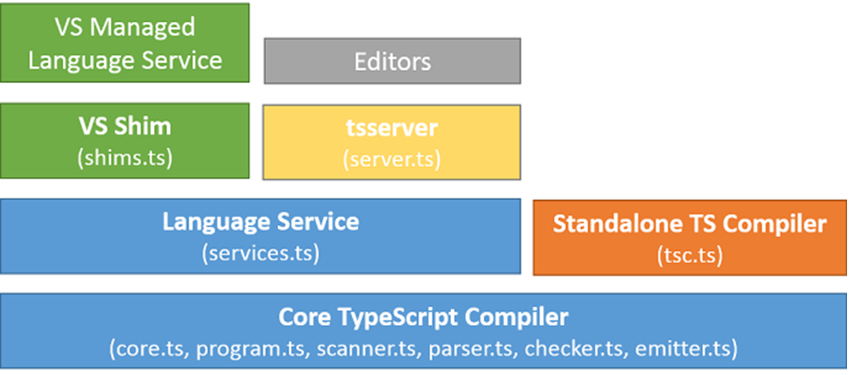

Slide 22
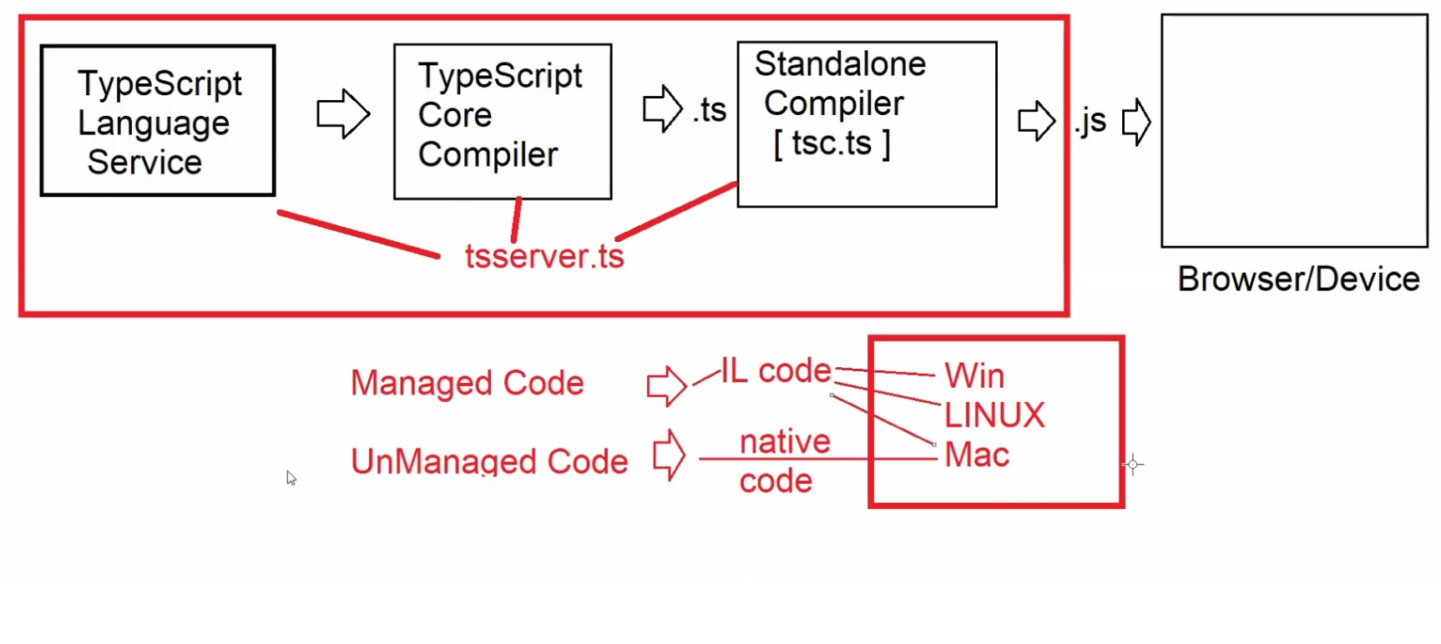

Slide 23
Note : Typescript is superset to JavaScript hence all javascript programs are valid in typescript
TypeScript Language Basics
1. Variables
2. DataTypes
3. Operators
4. Statements
Variables in TypeScript- Variables are simply storage locations in memory where you can store a value and use it as a part of any expression.
Variable configuration in computer programming includes 3 stages
a) Declaration
b) Rendering / Assigning
c) Initialization
var x;→ Declaration
x = 10; → Rendering
var x = 10; → Initialization
- JavaScript can directly render a value without declaration if it is not defined in strict mode.- Declaring variable is not mandatory in JavaScript untill or unless it is defined in strict mode.- Declaring or Initalizing variable is mandatory if javascript is in strict mode

Slide 24
- TypeScript is by default in strict mode of JavaScript,
hence in TypeScript declaring or initializing variable is mandatory.
- Variables in TypeScript can be declared or initialized by using the following keywords:
a) var b) let c) const
var (vs) let (vs) const
var
It defines a function scope variable.
Variable can be declared and accessed anywhere inside the function.
var allows declaration, rendering and initialization.
Ex:
function f1(){
var x = 10; var y;
if(x==10) {
y = 20; var z = 30;
}
console.log("x=" + x + “/n" + "y=" + y + “/n" + "z=" + z);}
f1();

Slide 25
var allows shadowing.
Shadowing is the process of re-defining same name variable i.e
same identifier inside the given context.
Example :
- var allows hoisting.
Hoisting allows to declare or initialize a variable after using i.e the is no order dependency in declaring and using variables.
Ex:function f1(){ x = 10; console.log("x=" + x); var x; // x is hoisted}f1();
let :-
- let is to define a block scope variable.
It is accessible only with in the defined block.
It allows declaring, rendering, initialization.
It will not allow shadowing. [Cannot redeclare block-scoped variable]-
It will not allow hoisting.

Slide 26
const:- const is to define a block scope variable.
It is accessible only with in the defined block.
It allows only initialization.
You can't declare or render / assign.
const x = 10; // valid
const x; // invalid
x=10; // invalid
- Every const must be initialized.
It will not support shadowing.
{ const x = 10; const x = 20; // invalid - can't shadow }-
It will not support hoisting.
Feature | var | let | Const
Scope | Function | Block | Block
Declaring | yes | yes | No
Assign/Render | Yes | yes | No
Shadow | Yes | No | No
Hoisting | Yes | No | No
Initialization | Yes | Yes | yes

Slide 27
Variable name can't be more than 255 chars.
Datatype determines the type of value that can be stored in a memory reference.
JavaScript is implicitly typed language, the data type for any memory reference will be determined according to the value assigned or initialized.
var x = 10; //number
var x = "John"; // string- JavaScript is not strongly typed.
The types will not strictly restrict the value.
It allows to render any value.
var x = 10; // number
x = "John"; // string - valid
x = true ; //
bool – valid
- TypeScript is a strongly typed language.- The data type defined for any variable will allow only the specific type.- Explicitly we have to define the datatype for variable.-
According the value defined , TypeScript can strictly restrict the value type even when the type is not defined.- TypeScript follows a "Duck Typing" mechanism. Note: Duck typing in computer programming is an application of the duck test - "If it walks like a duck and it quacks like a duck, then it must be a duck

Slide 28
". To determine if an object can be used for a particular purpose. We can exactly specify and understand what the type of value it can handle.Syntax:
let variableName : dataType = value;
- The root type for all datatypes in TypeScript is "any"- "any" is a type that can handle any value.- All datatypes in typescript are derived from "any“
[ it is the base type for all types ]-
The datatypes are categorized into 2 groups
a) Primitive Types b) Non-Primitive Types
Primitive Types- Stored in memory stack- It uses Last-in First-out- It have a fixed range for value.- Values are stored and accessed directly by using the allocated memory reference name.- The typescript primitive types are a) number b) boolean c) string d) null e) undefinedSyntax: let id : number = 1; id = "John"; // invalid id = 2 ; // valid

Slide 29
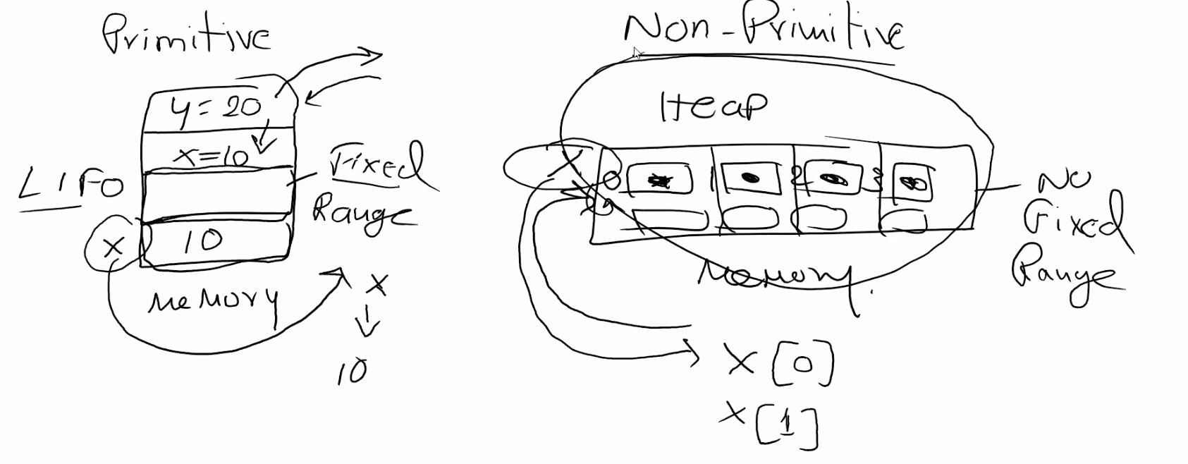
"any" is the root type for all data types
1. Primitive Types

Slide 30
Primitive Types:-
Allocated with stack memory.
Stored and accessed by using LIFO [last-in first-out]
Have fixed range for value.
Values are stored in a direct memory reference and are accessed by using the reference.
TypeScript primitive types are:
1.number
2. Boolean
3. string
4. null
5. undefined
Syntax:let variableName: dataType = value;
Note: TypeScript is case sensitive.

Slide 31
Type Script Primitive Types:
Number Type:- Number type is used to store numeric value.
Number type is defined by using "number" keyword
You can use number type for storing
Signed Integer - 10
Unsigned Interger 10
Floating Point 4.5
Double 540.560
Decimal 4.607969588543 [29]
Exponent 2e3 2x10[3] = 2000
Hexadecimal 0xf00d
Binary 0b1010
Octal 0o744

Slide 32
Boolean Type
Boolean values are used for decision making.
Boolean types in javascript are defined with "true/false" and also "0/1".
true = 1 false = 0
TypeScript boolean types are defined only by using "true or false" not 0 and 1.
Boolean conditions are also verified only by using "true or false" not 0 and 1.
Boolean types are declared by using the keyword "boolean".
Syntax: let isInStock:boolean = true;
if(isInStock==true) // valid
if(isInStock==1) // invalid3.
String Type- String is a literal with a group of characters enclosed in
double quotes " "
b) single quotes ' ‘
c) backtick ` `

Slide 33
- A string literal contains alpha numeric and special characters.
- String is declared by using the keyword "string".
- String is enclosed with double, single quote or backtick.
- We can use double and single quotes to swap between the outer and inner string.
Syntax:let userName:string = "John"; // valid
let userName:string = 'John'; // valid
let userName:string = `John`; // valid-
Single and Double quotes can swap between inner and outer string:
let msg:string = "alert('Hello !’)”; // valid
let msg:string = 'alert("Hello !")'; // valid
let msg:string = 'alert('Hello !')'; // invalid
let msg:string = "alert("Hello !")"; // invalid-

Slide 34
BackTick was introduced into JavaScript from version ES5.
BackTick defines a string embeded with expression.-
Expression in a string representation is defined by using "${ }“
- BackTick is used for templated string.
- Templated string comprises of presentation and logic.
Ex:let Age:number = 26;
let msg1:string = "You will be" + " " + (Age+1) + " " + "Next Year";
let msg2:string = `You will be ${Age+1} Next Year`;
console.log(msg1);console.log(msg2);-
A string literal with special characters may escape printing for certian characters.
You have to print the non-printable chars by using “/".

Slide 35
Ex:let Age:number = 26;
let msg1:string = "You will be" + " " + (Age+1) + " " + "Next Year";
let msg2:string = `You will be ${Age+1} Next Year`;console.log(msg1);console.log(msg2);-
A string literal with special characters may escape printing for certian characters.
You have to print the non-printable chars by using “\".Ex:let path:string = "\"D:\\Images\\Pic\\tv.jpg\"";console.log("Path=" + path);O/P : "D:\Images\Pic\tv.jpg"

Slide 36
4. undefined type:
Undefined is a type defined for variables that are not configured with a value i.e
variable is declared but value not assigned.
The keyword undefined is used to verify the value defined or not.
Ex:let price:number;price = 45000.54;if(price==undefined) { console.log("Please Provide Price");} else {console.log(`Price = ${price}`);}
Note: TypeScript supports union of types. A variable can be declared with multiple types. let variableName:dataType1|dataType2|.
.;Ex:let price:number|undefined;if(price==undefined) { console.log("Please Provide Price");} else {console.log(`Price = ${price}`);}5.
null type: Null is a type that returned when no-reference found for a variable during runtime. Null is an exception caught at run time when value is not defined for any reference. You can verify by using the keyword "null".

Slide 37
Check like open with browser or live Server from Extensions
TypeScript Primitive Data Types
Number
2. String
3. Boolean
4. null
5. Undefined
TypeScript Non Primitive Types
Non Primitive types are stored in memory heap.
Heap is the computers cache memory.
The size of memory varies according to browser and device.
They don't have any fixed range for value.
The value range will vary according to Browser and device.-
They are stored and accessed by a reference in memory i.e not directly stored in memory, they are allocate with a reference in memory.
- The typescript non-primitive types are
1. Array
2. Object
3. Regular Expression

Slide 39
Array Type
Arrays are used in computer programming to
a) Reduce Overhead
b) Reduce Complexity-
Array reduces overhead by storing values in sequential order.
- Array reduces complexity by storing many value under one name.
- Array is a collection of values.-
Array can store various type of value.
- Array size can be changed dynamically.-
TypeScript Array can be restricted to store similar type of value or various types of values.-
TypeScript Array size can be changed dynamically.-
TypeScript Array can have the behavior of a collection like stack, queue or any dictionary type.
Delaring and Initializing Array in TypeScript:-
Array is declared by using the meta character "[ ]".
? zero or one occurance
+ one or more occurances
* zero or more occurances
[ ] range , min and max

Slide 40
Syntax: let variableName:dataType[];
Memory for array is initialized by using
a) Meta Character [ ]
b) Array Constructor Array()
Syntax:
let variableName:dataType[] = [ ];
let variableName:dataType[] = new Array();-
Meta Character "[ ]" allows a Tuple, if data type is "any" type then it allows to store different types of value.
- Array Constructor will not allow to store different types of values even when the data type is "any".

Slide 41
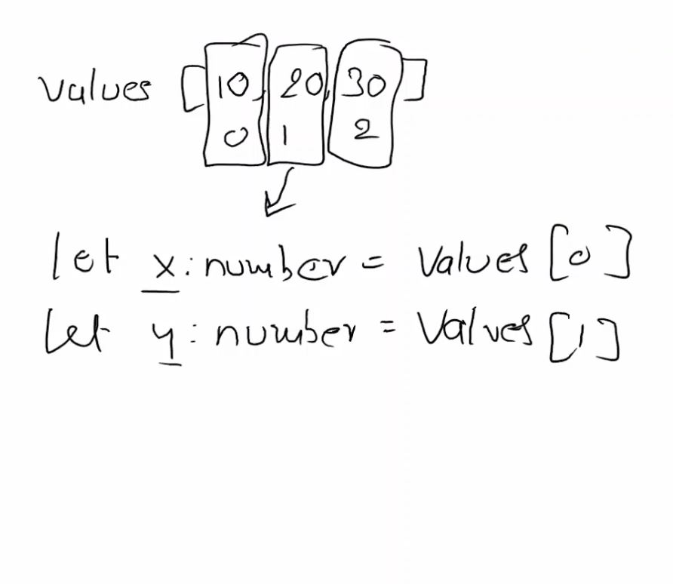
Array Destruction:- Destruction is the process that allows to access the elements from array and store in the reference of individuals variables. Destruction is shown below without destruction techneqics

Slide 42
Here we are distructing the array into individual using ES5 technique
let productsitem:string[] = ["samsung","MI "]
let [tv,mobile] = productsitem;
console.log(`tv = ${tv} / n mobile = ${mobile}`)
Array Manipulations
Reading Values from an Array
1)ToString(),Join(),find(),filter() -- Functions
2) for...in,for...of – operators(iterators)
3)For – Loop
Iterator – Will reads all the elements in sequential order. It does not require Initialision,Condition,increment like the loop.
description- It can read all values and return as string with "," delimiter.
function toString()
Ex:
let products:string[] = ["Samsung TV", "MI Mobile"];
console.log(products.toString());

Slide 43
Function - join()
Discripstion - It can read all values and return as String with user defined delimiter.
Ex:
let products:string[] = ["Samsung TV", "MI Mobile"];
console.log(products.join("-->"));
Function - find() introduced in new javascript version (later we can observe in tsconfig file configuration of ts
Discripstion - It can search the array for any value by using the given condition and return the first occurance value that matches the condition.
Ex:let productsPrice:number[] = [43000.44, 23000.44, 5000.30, 50000.50, 4000.50];
function Search(price) { return price<=10000;}
let result:number = productsPrice.find(Search)
console.log(`Returned Value : ${result}`);

Slide 44
Fuction -filter()
Discription : It is similar to find but, it can return all values that are matching with condition specified. It returns an array.
Ex:let productsPrice:number[] = [43000.44, 23000.44, 5000.30, 50000.50, 4000.50];
function Search(price) { return price<=10000;}
let result:number[] = productsPrice.filter(Search)
console.log(`Returned Value : ${result.toString()}`);
Ex:let productsPrice:number[] = [43000.44, 23000.44, 5000.30, 50000.50, 4000.50];let result:number[] = productsPrice.filter(function(price){ return price>=10000;})console.log(`Returned Value : ${result.toString()}`);
Sending as call back function --- That executes automatically.
for...in It is an iterator that returns all properties of an array. Based on properties you can accessvalues.

Slide 45
Ex:let products:string[] = ["TV", "Mobile", "Shoe"];
for(var property in products) { console.log(`${property} : ${products[property]}`);}
Property -- index numbers
for...of It is an iterator uses to read all values from a collection.
Ex:let products:string[] = ["TV", "Mobile", "Shoe"];for(var value of products){ console.log(value);} for It creates a loop for reading values based on initialization,condition and counter.
Ex:let products:string[] = ["TV", "Mobile", "Shoe"];for(var i=0; i<products.length; i++) { console.log(products[i]);}

